Slide 1

CSE3251
Computer Networks
Dr. Asif Zaman
Professor, CSE, RU

Slide 2
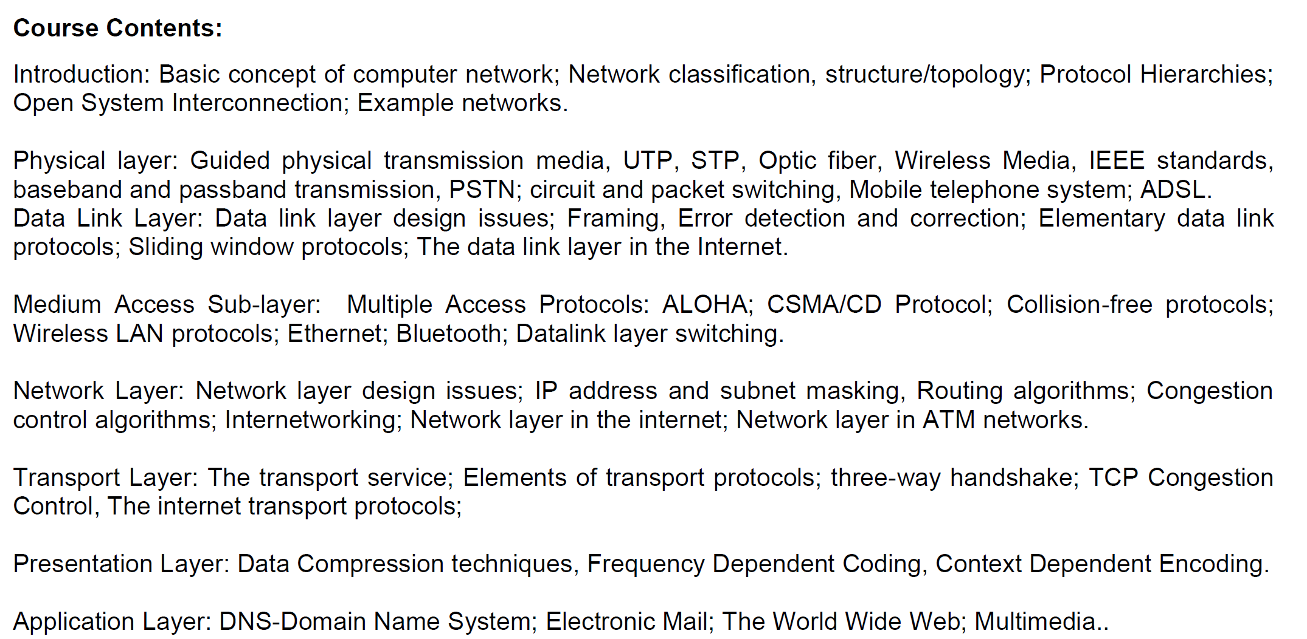

Slide 3
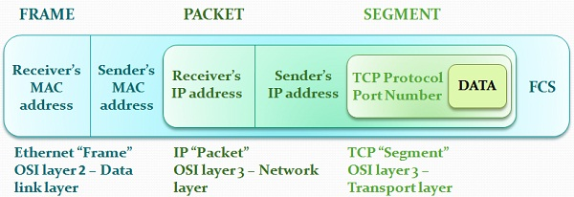
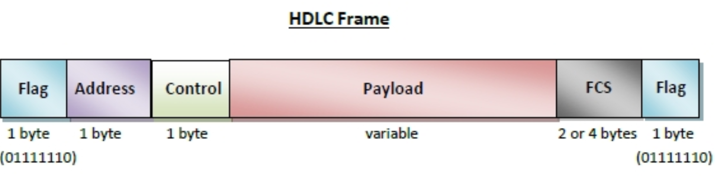
The Story

Slide 4
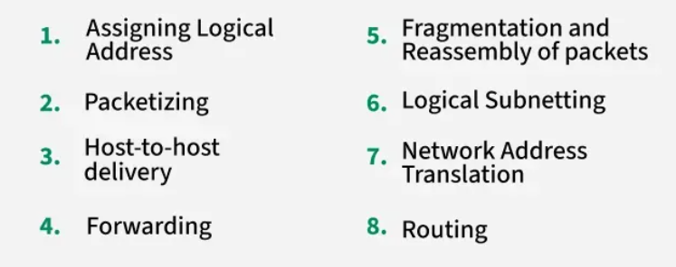
Key functions of the network layer
Ref: https://www.geeksforgeeks.org/network-layer-services-packetizing-routing-and-forwarding/

Slide 5
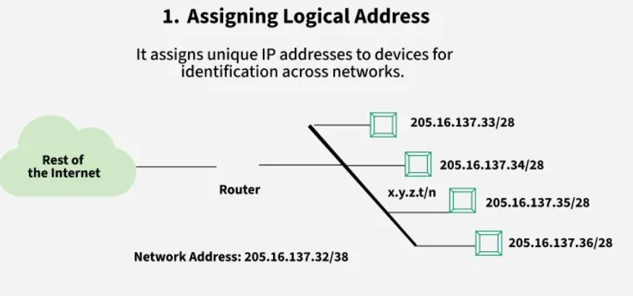
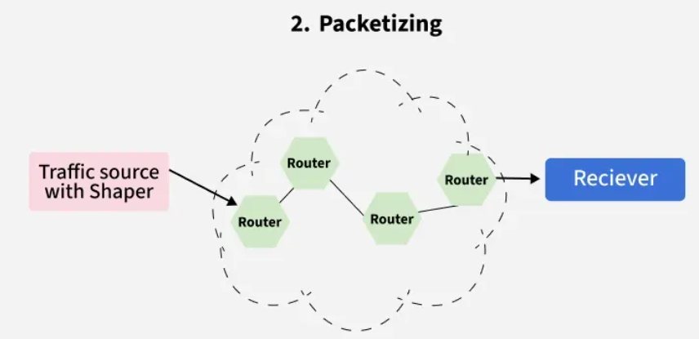

Slide 6
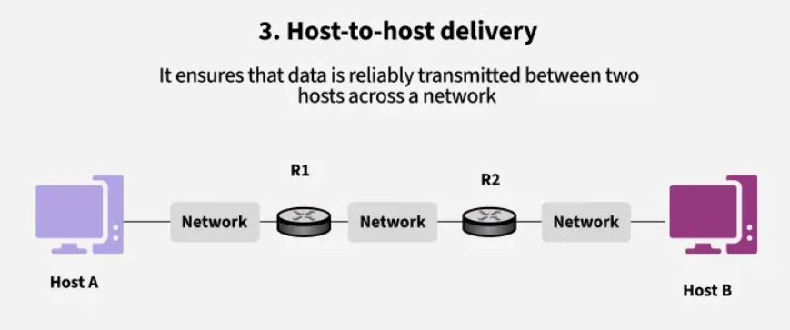
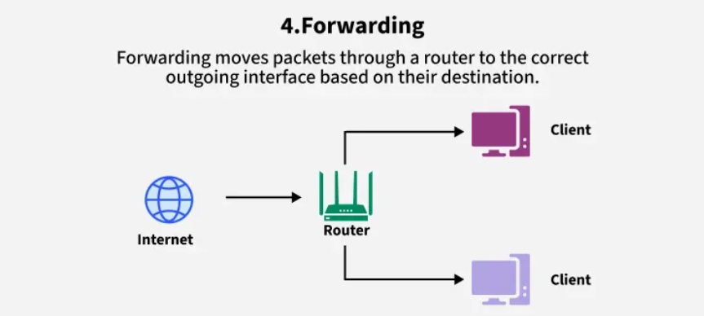

Slide 7
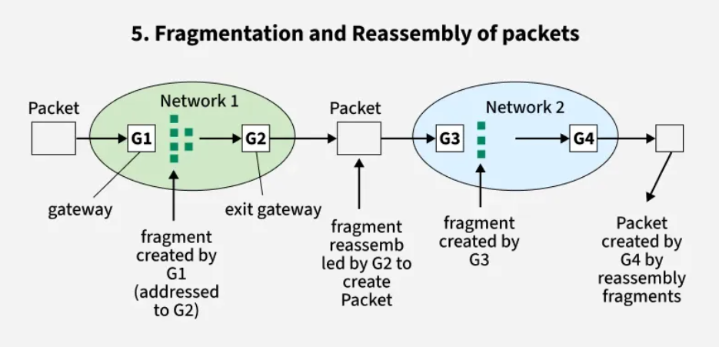
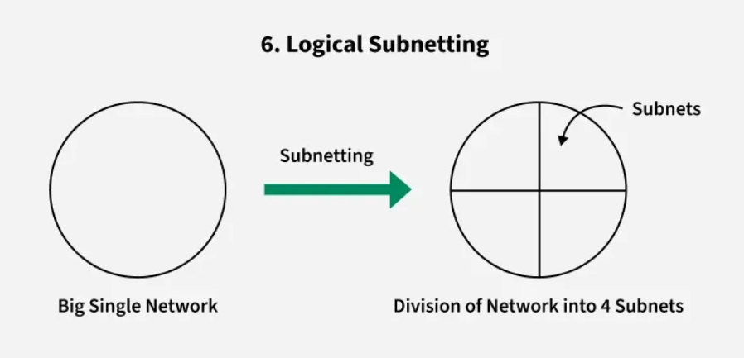

Slide 8
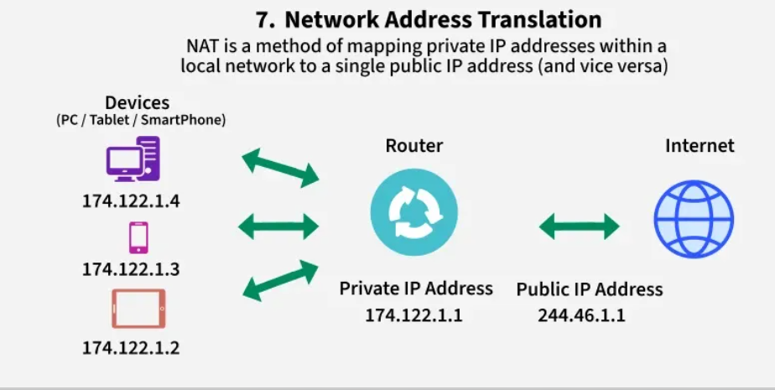
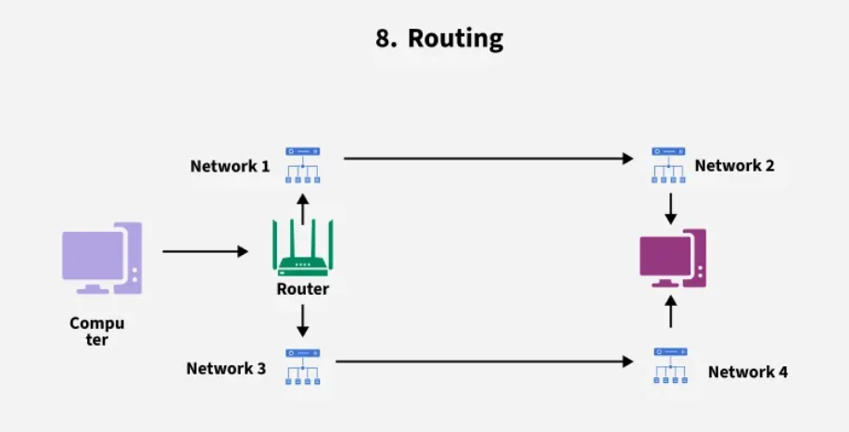

Slide 9
What is an IP Address?
… is a unique string of numbers assigned to each device connected to a computer network
… uses the Internet Protocol for communication.
It serves as an identifier that allows devices to send and receive data over the network, ensuring that this data reaches the correct.

Slide 10
Types of IP Address
Based on Addressing Scheme
(IPv4 vs. IPv6)
Based on Usage
(Public vs. Private)
Based on Assignment Method
(Static vs. Dynamic)

Slide 11
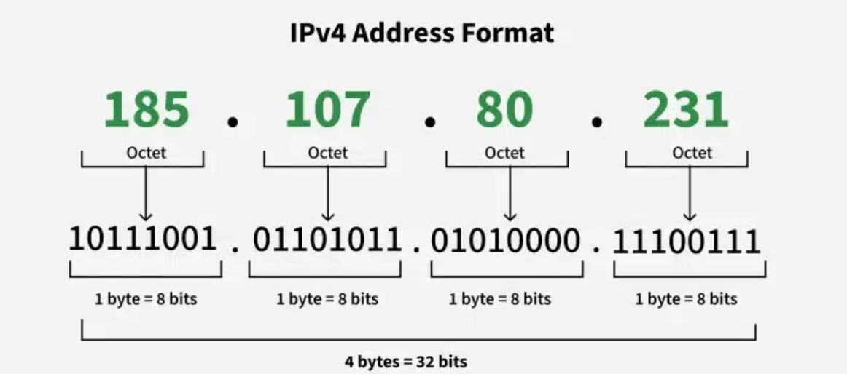
IPv4

Slide 12

An IP address is a 32-bit address.
The IP addresses are unique.

Slide 13
Address Space
An address space defines a range of discrete addresses, each of which may correspond to a network host, peripheral device, disk sector, a memory cell or other logical or physical entity.
…………..
…………..
addr1
addr15
addr2
…………..
…………..
…………..
addr41
addr226
addr31
…………..
…………..

Slide 14
Address Space Regulation
…………..
addr15
The address space in a protocol
That uses N-bits to define an
Address is:
2^{N}
addr2
…………..
…………..
…………..
addr41
addr226
addr31
…………..
…………..

Slide 15
IPv4 address space
The address space of IPv4 is
2³² or 4,294,967,296.
429 Crore+

Slide 16
Binary Notation
11000000 10101000 00000000 00000001
192 . 168 . 0 . 1

Slide 17

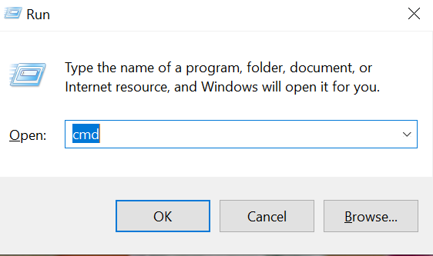
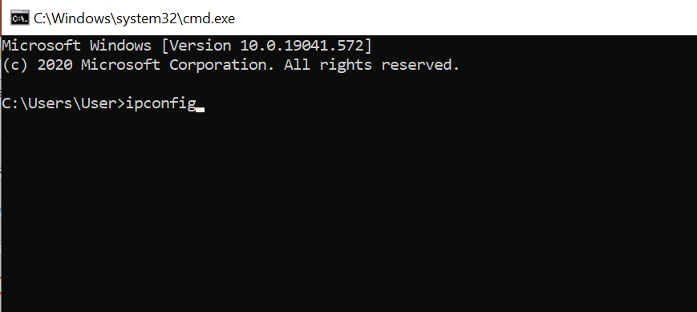
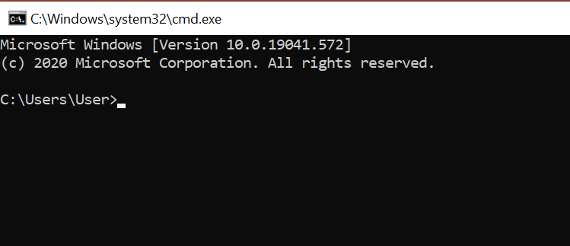
+ R

Slide 18
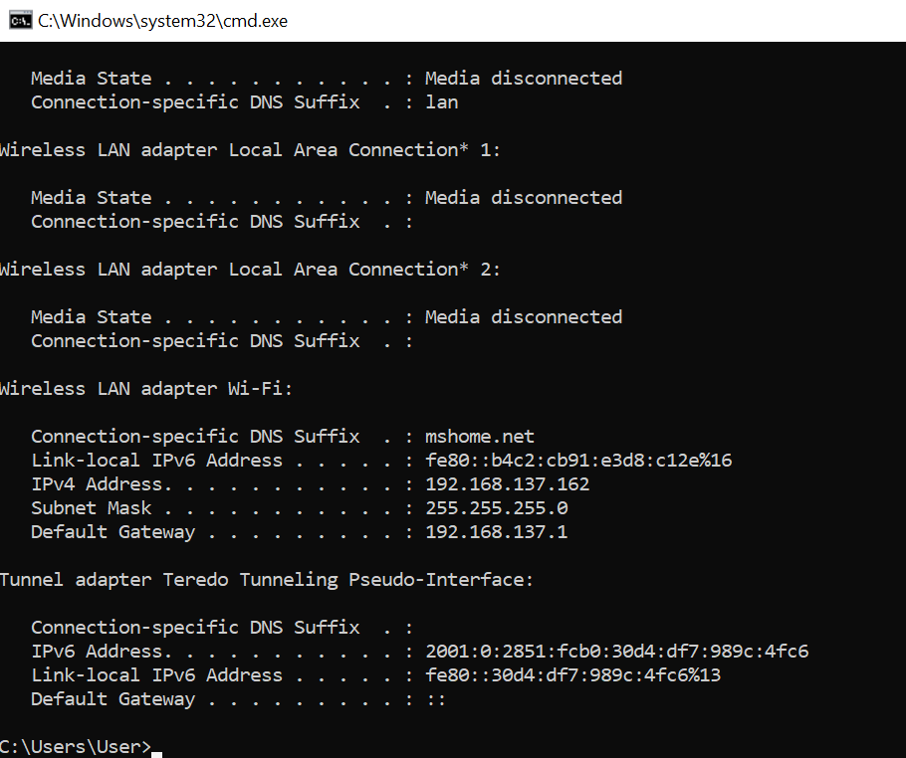

Slide 19
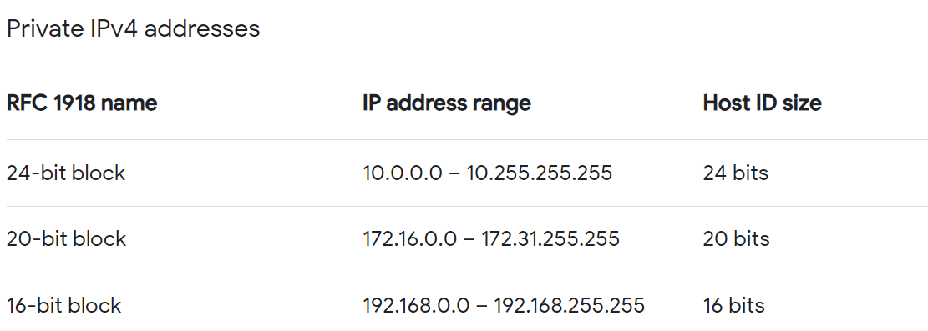
Public vs Private IP Address
A Request for Comments (RFC) is a publication from the Internet Society (ISOC) and its associated bodies, most prominently the Internet Engineering Task Force (IETF), the principal technical development and standards-setting bodies for the Internet.

Slide 20
CLASSFUL
ADDRESSING

Slide 21
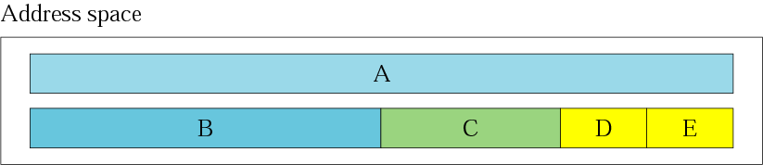
Occupation of the address space
In classful addressing the address space is
divided into 5 classes:
A, B, C, D, & E

Slide 22
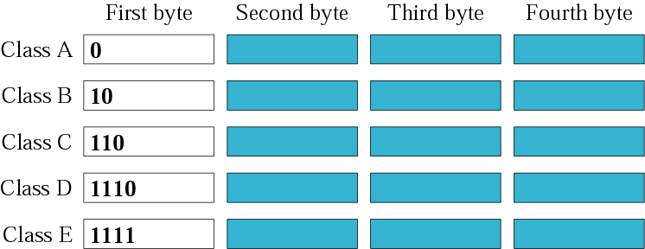
Finding the class in binary notation

Slide 23
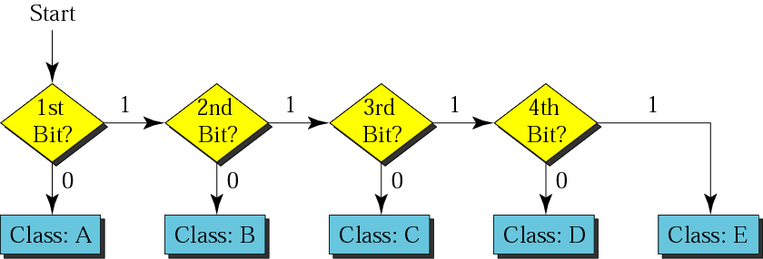
Finding the address class

Slide 24
Example
01000000 10101000 00000000 00000001
Show that Class A has
2³¹ = 2,147,483,648 addresses
214 Crore+

Slide 25
Example
Find the class of the following IP addresses
00000001 00001011 00001011 11101111
11000001 00001011 00001011 11101111
00000001 00001011 00001011 11101111
1st is 0, hence it is Class A
11000001 00001011 00001011 11101111
1st and 2nd bits are 1, and 3rd bit is 0 hence, Class C

Slide 26
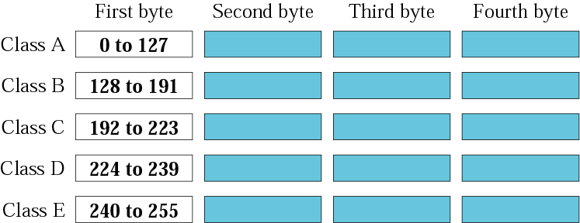
Finding the class in decimal notation
00000000 → 01111111 (127)
10000000 (128) → 10111111 (191)
11000000 (192) → 11011111 (223)

Slide 27
Example
Find the class of the following addresses
158.223.1.108
227.13.14.88
158.223.1.108
1st byte = 158 (128<158<191) class B
227.13.14.88
1st byte = 227 (224<227<239) class D

Slide 28
Port number
Default Port:1-1024
Ping: 7
DHCP: 68
158.128.1.108:25
the for octet before colon is the IP address
The number of colon (25) is the port number
16-bit integer, so 65535.

Slide 29
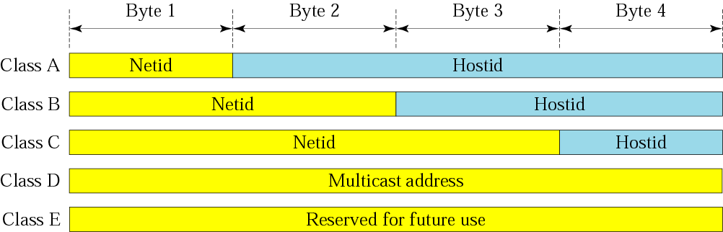
Netid and hostid

Slide 30
73.X.X.X
Router

Slide 31
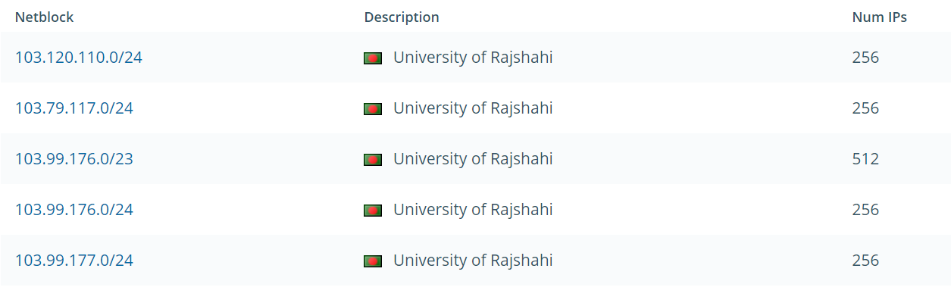
RU IP Block

